Slide 1
ns-3 Network Simulator
Tugrul Yatagan
yatagan@itu.edu.tr

Slide 2
Outline
Introduction
Architecture
Build
Examples

Slide 3
Introduction
Architecture
Build
Examples
Overview
ns-3 is a discrete-event network simulator, targeted primarily for research and educational use developed by UC Berkeley licensed under the GNU GPLv2 license.
ns-3 software infrastructure encourages the development of simulation models which are sufficiently realistic to allow ns-3 to be used as a real-time network emulator, interconnected with the real world and which allows many existing real-world protocol implementations to be reused within ns-3.
ns-3 simulation core supports research on both IP and non-IP based networks. Wireless/IP simulations which involve models for Wi-Fi, WiMAX, or LTE for layers 1 and 2 and a variety of static or dynamic routing protocols such as OLSR and AODV for IP-based applications.
ns-3 is not compatible with ns-2. ns-3 is actively maintained; ns-2 is only lightly.
https://www.nsnam.org/overview/what-is-ns-3/

Slide 4
Introduction
Architecture
Build
Examples
Documentation
Official ns-3 documentation;
https://www.nsnam.org/documentation/
Official ns-3 API documentation;
https://www.nsnam.org/docs/doxygen/index.html
Official ns-3 tutorial;
https://www.nsnam.org/docs/tutorial/singlehtml/index.html
Official ns-3 installation guide;
https://www.nsnam.org/wiki/Installation
C++
The C++ Programming Language by Bjarne Stroustrup

Slide 5
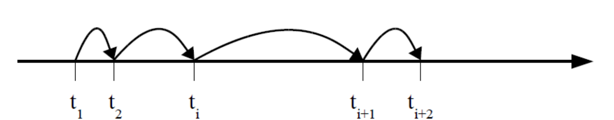
Introduction
Architecture
Build
Examples
Discrete Event Simulation
The idea is to jump from one event to another.
Events are recoded in a future event list (FEL).
Each event notice is composed at least to data: time, type.
Event routine or handler to process each event.
Each event may change the system state and generate new event notices
http://users.jyu.fi/~arjuvi/opetus/tiea322/2015/Lecture2_Petrov.pdf

Slide 6
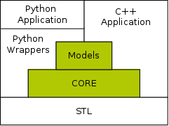
Introduction
Architecture
Build
Examples
Architecture
ns-3 is a C++ library which provides a set of network simulation models implemented as C++ objects and wrapped through Python.
Users normally interact with this library by writing a C++ or a Python application which instantiates a set of simulation models to set up the simulation scenario of interest, enters the simulation main loop, and exits when the simulation is completed.
ns-3 is primarily developed on GNU/Linux platforms.
https://www.nsnam.org/overview/key-technologies/

Slide 7
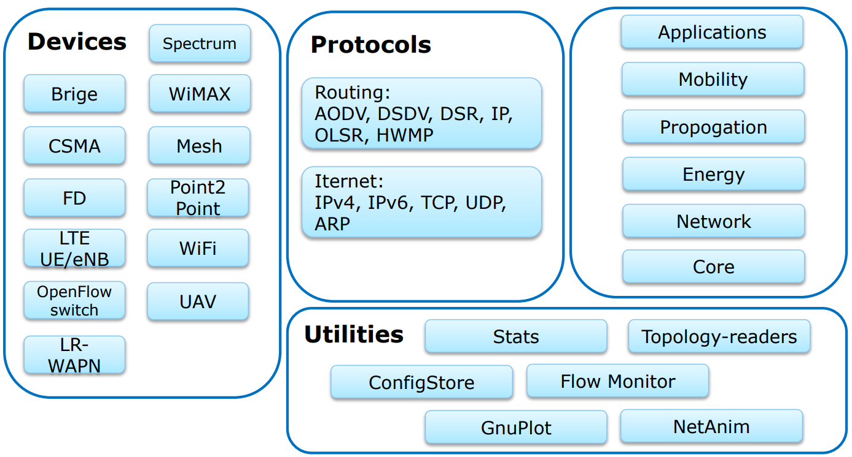
Introduction
Architecture
Build
Examples
Modules
http://users.jyu.fi/~arjuvi/opetus/tiea322/2015/Lecture2_Petrov.pdf

Slide 8
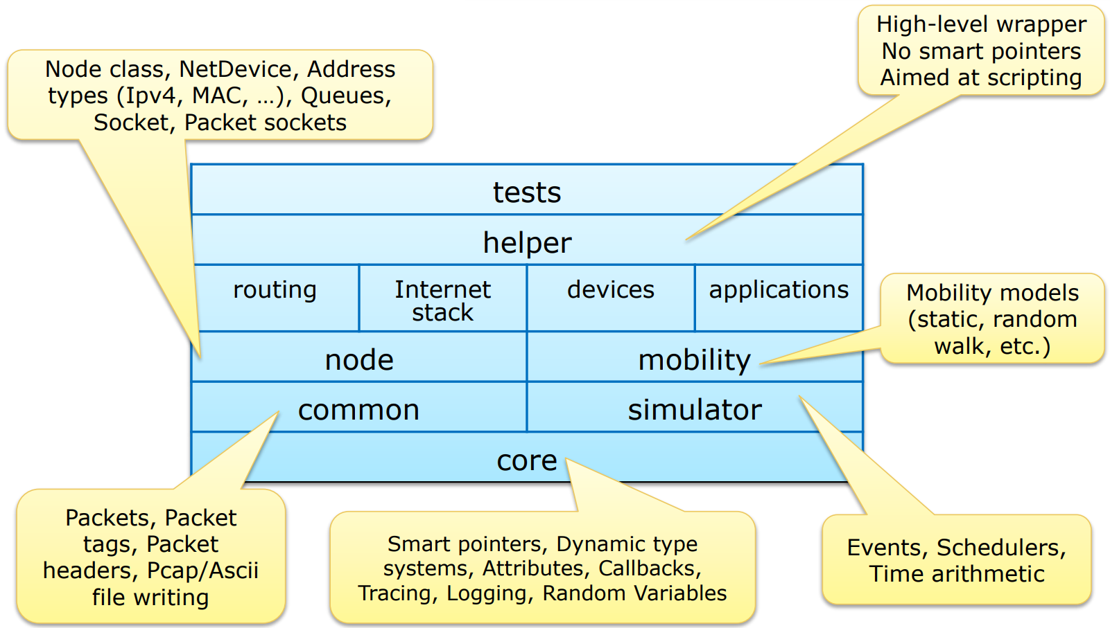
Introduction
Architecture
Build
Examples
Structure
http://users.jyu.fi/~arjuvi/opetus/tiea322/2015/Lecture2_Petrov.pdf

Slide 9
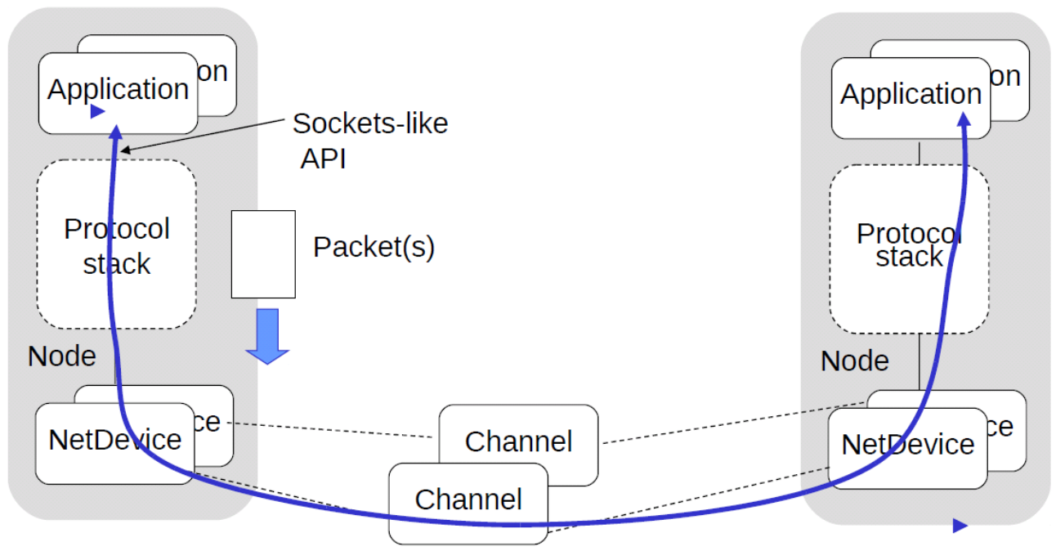
Introduction
Architecture
Build
Examples
Architecture Elements
Node;
Computer, access point, NIC.
Net device;
Ethernet NIC, WifiNetDevice.
Channel;
CSMA Channel, WifiChannel.
Link;
Point-to-point, Bridge, Wifi, Mesh.
Application (traffic generators);
On-Off: Generates streams, alternating on-and-off periods, either UDP or TCP.
Packet sink: receives packets or TCP connections.
Ping6, v4ping: send ICMP ECHO request.
Udp-client/server: sends UDP packet with sequence number.
Udp-echo: sends UDP packet, no sequence number.
https://www.cpe.ku.ac.th/~anan/myhomepage/wp-content/uploads/2013/06/2013-ns3-part1-introduction.pdf

Slide 10
Introduction
Architecture
Build
Examples
Development Environment
Ubuntu 16.04 is suggested;
https://www.ubuntu.com/download/desktop
Virtualbox is suggested if Linux installation is not possible;
https://www.virtualbox.org/wiki/Downloads
At least 2 GB memory.
At least 20 GB hard drive.
At least 2 CPUs.
After successfully obtaining environment, install following libraries and tools on Ubuntu machine;
sudo apt-get update sudo apt-get upgrade -y sudo apt-get install gcc g++ python python-dev qt5-default python-pygraphviz python-kiwi python-pygoocanvas libgoocanvas-dev ipython openmpi-bin openmpi-common openmpi-doc libopenmpi-dev autoconf cvs bzr unrar gdb valgrind uncrustify python-sphinx dia flex bison libfl-dev tcpdump sqlite sqlite3 libsqlite3-dev libxml2 libxml2-dev doxygen graphviz imagemagick texlive texlive-extra-utils texlive-latex-extra texlive-font-utils texlive-lang-portuguese dvipng
https://www.nsnam.org/wiki/Installation

Slide 11
Introduction
Architecture
Build
Examples
Build
Download and extract latest ns-allinone release tarball.
https://www.nsnam.org/release/
Build ns-3;
cd ns-allinone-3.* ./build.py --enable-examples --enable-tests
Build ns-3 application;
cd ns-* ./waf
Test ns-3; (optional)
./test.py -c core
https://www.nsnam.org/docs/tutorial/html/getting-started.html

Slide 12
Introduction
Architecture
Build
Examples
Run Example
There are several examples under examples folder. To run an example, copy it to scratch folder.
cp examples/tutorial/first.cc scratch/ ./waf --run scratch/first cp examples/tutorial/second.cc scratch/ ./waf --run scratch/second cp examples/traffic-control/traffic-control.cc scratch/ ./waf --run scratch/traffic-control
To enable log messages:
NS_LOG="<log-component>=<option>|<option>...:<log-component>..."
cp examples/tutorial/first.cc scratch/ NS_LOG=="star=all" ./waf --run scratch/star
https://www.nsnam.org/docs/manual/html/logging.html

Slide 13
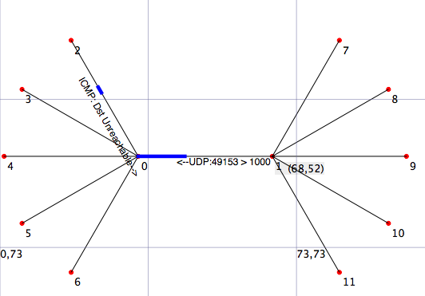
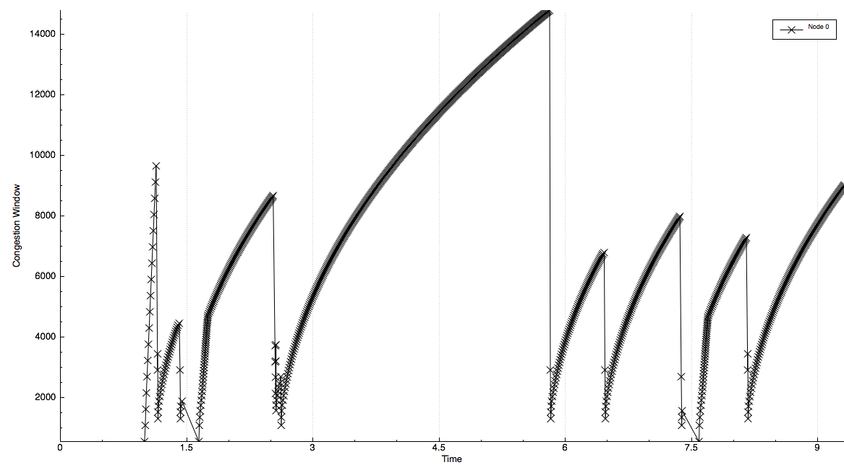
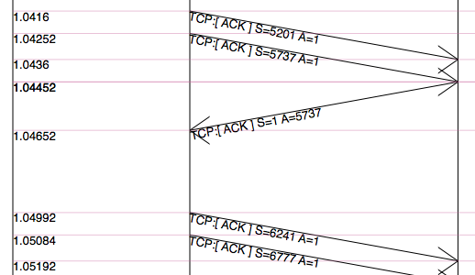
Introduction
Architecture
Build
Examples
NetAnim
NetAnim is an offline network animator tool which ships along with the ns-allinone-3.xx package.
https://www.nsnam.org/wiki/NetAnim_3.108
https://www.youtube.com/watch?v=-9a6dVbOds4
It can animate the ns-3 network simulation using an XML trace file that is generated as an output during simulation.
Build NetAnim;
cd netanim make clean qmake NetAnim.pro make
https://www.nsnam.org/wiki/NetAnim_3.108

Slide 14
Introduction
Architecture
Build
Examples
NetAnim
Run matrix topology example to create ns-3 XML trace.
cp examples/matrix-topology/matrix-topology.cc scratch/ ./waf --run scratch/matrix-topology cd netanim ./NetAnim
Netanim;
Open "*.anim.xml" in NetAnim.
Run simulation.
Observe stats and packets.
Pcap traces;
Enable "p2p.EnablePcapAll" on matrix-topology.cc.
Open pcap files with Wireshark to investigate received and transmitted packages per node.

Slide 15
Introduction
Architecture
Build
Examples
General Structure of a Script
Handle command line arguments.
Set default attribute values.
Create nodes.
Configure physical and MAC layers.
Enable tracing.
Set up network stack, routing and addresses.
Configure and install applications.
Set up initial positions and mobility.
Connect trace sources and sinks.
Schedule user-defined events and start simulation.
http://www.uio.no/studier/emner/matnat/ifi/INF5090/v11/undervisningsmateriale/INF5090-NS-3-Tutorial-2011-Oslo-slides.pdf

Slide 16
Introduction
Architecture
Build
Examples
Common Script Elements
NodeContainer
Provides a convenient way to create, manage and access any Node objects.
Stores pointer to those objects internally.
The nodes as they stand in the script do nothing.
To construct a topology is to connect our nodes together into a network.
PointToPointHelper
To construct a point to point link.
Perform the low-level work required to put the link together.
Typically these two things NetDevice and Channel are intimately tied together (cannot expect to interchange).
Ethernet devices and CSMA channels.
Wifi devices and wireless channels
FlowMonitor
To provide a flexible system to measure the performance of network protocols.
Detect all flows passing through network.
Stores metrics for analysis such as throughput, duration, delays, packet sizes, packet loss ratios
https://www.cpe.ku.ac.th/~anan/myhomepage/wp-content/uploads/2012/01/ns3-part3-wireline.pdf

Slide 17
Thank you for your time.
Any questions?

Slide 18
References
https://www.nsnam.org/documentation/
https://www.nsnam.org/overview/key-technologies/
https://www.nsnam.org/wiki/Installation
https://www.nsnam.org/docs/tutorial/html/getting-started.html
https://www.nsnam.org/docs/manual/html/logging.html
https://www.nsnam.org/wiki/NetAnim_3.108
http://users.jyu.fi/~arjuvi/opetus/tiea322/2015/Lecture2_Petrov.pdf
http://www.uio.no/studier/emner/matnat/ifi/INF5090/v11/undervisningsmateriale/INF5090-NS-3-Tutorial-2011-Oslo-slides.pdf
https://www.cpe.ku.ac.th/~anan/myhomepage/wp-content/uploads/2013/06/2013-ns3-part1-introduction.pdf
http://personal.ee.surrey.ac.uk/Personal/K.Katsaros/ns-3-workshop-part1.html
http://personal.ee.surrey.ac.uk/Personal/K.Katsaros/media/NS-3-Presentation-2013.pdf
https://www.cpe.ku.ac.th/~anan/myhomepage/wp-content/uploads/2012/01/ns3-part3-wireline.pdf
https://www.cpe.ku.ac.th/~anan/myhomepage/wp-content/uploads/2014/09/ns3-lecture10-flowmon.pdf
http://www.uio.no/studier/emner/matnat/ifi/INF5090/v11/undervisningsmateriale/INF5090-NS-3-Tutorial-2011-Oslo-slides.pdf

